Slide 1
AJAX

Slide 2
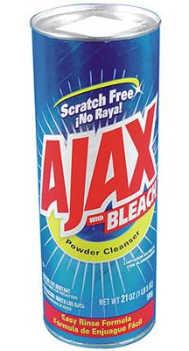
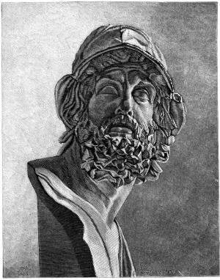



Slide 3
Introduction to AJAX
Asynchronous JavaScript and XML (AJAX)
Refers to a combination of technologies
Allows Web pages displayed on a client computer to quickly interact and exchange data with a Web server without reloading the entire Web page
AJAX primarily relies on JavaScript and HTTP requests to exchange data between a client computer and a Web server
XML is usually the format used for exchanging data

Slide 4
Problem
Getting information from a database on the server, or sending information to a server-side script like PHP,
HTML form to GET or POST data to the server
Click "Submit", wait for the server to respond
Load a new page with the results
With Ajax
JavaScript communicates directly with the server
Uses a special JavaScript object XMLHttpRequest
JavaScript uses object to get information from the server without having to load a new page
Other technologies that comprise AJAX
HTML, CSS, and the Document Object Model (DOM)

Slide 5
Introduction to AJAX
XMLHttpRequest object
Uses HTTP to exchange data between a client computer and a Web server
Can be used to request and receive data without reloading a Web page
Combining XMLHttpRequest with Document Object Model
You can update and modify individual portions of your Web page with data received from a Web server

Slide 6
Easy Example
HTML form with no buttons
Example01 has this form: <form name='myForm'> Name: <input type='text' name='username'/><br/> Time: <input type='text' id='time' name='time'/> </form>
Add JavaScript to display server time whenever value of username field changes
Notes:
Easy to do within the browser, but that defeats the purpose of what we’re trying to learn here.

Slide 7
Starting From the Browser…
Use JavaScript to
Handle events from the form
Create an XMLHttpRequest object
Send it (via HTTP) to the server
Receive the response
Process the information returned from the response
Nothing special is required of the server—every server can handle HTTP requests
The XMLHttpRequest object does not actually require XML

Slide 8
The XMLHttpRequest Object
JavaScript has to create an XMLHttpRequest object before it can request items on the server
var request = new XMLHttpRequest();
Other forms exist but they are for older browsers
Use try/catch to make sure it works
function getXMLHttpRequest { var request = false; try { request = new XMLHttpRequest(); } catch(e) { //do something } return request; }

Slide 9
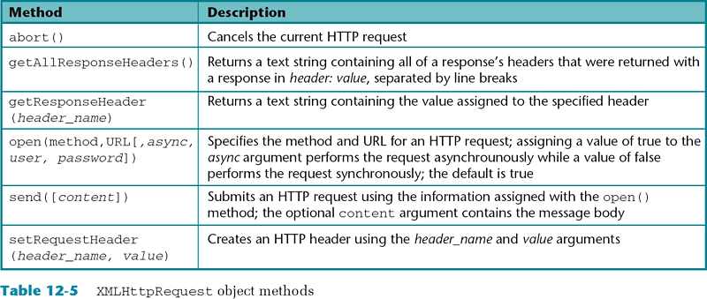
XMLHttpRequest Object Methods
Key to turning your JavaScript script into AJAX programs
Notes:
Example:
Create a PHP script that returns the RSS feeds for a selected news agency

Slide 10
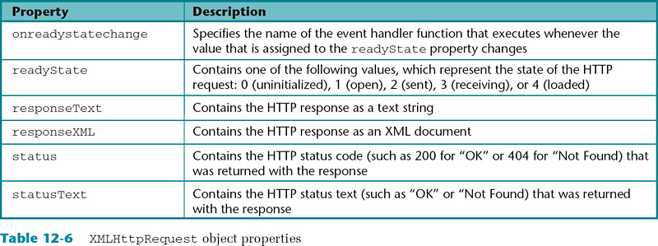
XMLHttpRequest Object Properties

Slide 11
Preparing the XMLHttpRequest Object
Once you have an XMLHttpRequest object, have to prepare it with the open method
request.open(method, URL, asynchronous)‏
The method is usually 'GET' or 'POST'
If using a 'GET', data is appended to the URL
If using a 'POST', data is added in a later step
The URL is where you are sending the data
If asynchronous is true, the browser does not wait for a response (this is what you usually want)‏
request.open(method, URL)‏
As above, with asynchronous defaulting to true

Slide 12
Sending the XMLHttpRequest object
Once the XMLHttpRequest object has been prepared, you have to send it
With a GET request request.send(null);
With a POST request request.send(content);
The content has the same syntax as the suffix to a GET request
Example: request.setRequestHeader('Content-Type',
'application/x-www-form-urlencoded'); request.send('var1=' + value1 + '&var2=' + value2);

Slide 13
On the Server Side
The server gets a standard HTTP request
PHP
$_GET and $_POST method
The response is a standard HTTP response
Instead of returning a complete HTML page as a response, the server can return text.
Server can send XML but must set content-type‏

Slide 14
Getting the Response
Ajax is (usually) asynchronous
Don’t wait for calls, handle an event when receive response
request.onreadystatechange = someFn;
This is a function assignment, not a function call
Assigns the function someFn to be called whenever the readystatechange event occurs
When the function is called, it will be called with no parameters
Set up the handler (someFn) before you call the send function so no chance of it not being ready
Notes:
Actually called a lambda function for anyone who is thinking of python or scheme or lisp

Slide 15
Browser Side Implementation
Create an XMLHttpRequest object
Open the request object
Specify where to process the response
Send the request

Slide 16
readyState Property
XMLHttpRequest object property called readyState
Change in readyState causes onreadystatechange event
readyState property defines the state of the XMLHttpRequest object
readyState=0 XMLHttpRequest object created but not open()
readyState=1 open() method called but not send()
readyState=2 send() method called but no response yet
readyState=3 server has not completed the response
readyState=4 the response data have been completely received from the server.
Usually you are only interested in state 4
Notes:
Note: no error return value of the readyState. You will receive a response unless the server times out.

Slide 17
Processing the Response
Check the readyState property of request object
Will be set to 4 when complete
Also want to check the return code status for 200
If necessary, use getElementsByTagName to extract the information you want
Update HTML of page based on response
Use setTimeout() to call again with request (if necessary)
Notes:
Show TopStories.html

Slide 18
Event Handler Function for Response
Need a function to handle the data
First check readyState to make sure that the response is completely back
function someFn() { if((request.readyState == 4) and (request.status == 200)){ var response = request.responseText; // Do something with the response } }

Slide 19
Server Side Processing (in PHP)
Retrieve any data from call (GET or POST)
Set the header return type (as necessary)
Set the length of return type
Set cache-control to no-cache
Read or echo location of request
Note: No interface on server side
Notes:
Show sportingnews.php and stockcheck.php

Slide 20
response Object
response object needs to be treated differently depending on what type of response object
Change content-type of response header to determine which way to handle the response
responseXML
responseText
responseJSON
Developer should know what is expected
Notes:
Finish example01 and have it run.

Slide 21
Using response Data
When you specify the callback function, request.onreadystatechange = someFn; you can’t specify arguments
Two solutions:
Function can use the request object as a global variable
Bad idea if you have multiple simultaneous requests
Assign an anonymous function:
request.onreadystatechange = function() { someFn(request); }
Here the anonymous function calls your someFn with the request object as an argument.

Slide 22
Reading Returned Values
Use JavaScript to access returned data
Data can be static (a file from the server) or generated by a request
Need a server side program to get data and return in response object
Note: XML can read data directly, but only from its own domain. This is a security limitation of JavaScript

Slide 23
Updating the DOM
Update the web page by changing the values using the properties of the DOM
getElementById()
getElementsByName()
getElementsByTagName()
Use innerhtml property to update elements on the web page
Can also change the class, make things display or not, etc

Slide 24
What is XML?
Platform independent
Software independent
Vendor- and technology-independent meta-language
Designed to deliver structured content over the Web
Notes:
Why is this important?

Slide 25
An XML Document
An XML document complies with the XML DOM standards
An XML DOM states that XML documents must have a logical structure
The root container element (node) must nest all the elements and data
The root node can contain many other elements
All tags must be nested within the root node (or root tag)‏
The root node is a container element because all elements must be nested within the root element in an XML document

Slide 26
The Element Hierarchy
Elements are the building blocks of XML
Elements contain an opening tag and a closing tag
Content is stored between the tags
Displaying XML documents
Simple text editors - most typical
Tree diagram - typical for more complicated diagrams

Slide 27
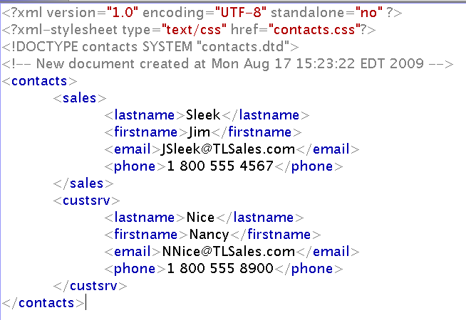
contacts.xml
contacts
sales
custsrv
lastname
firstname
email
phone
lastname
firstname
email
phone

Slide 28
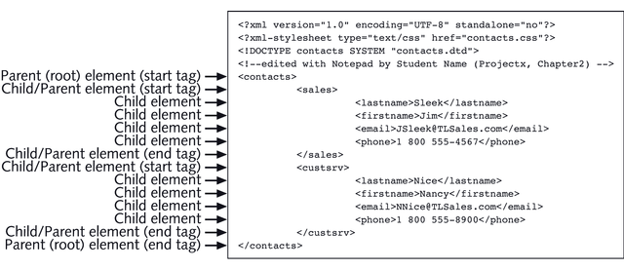
Element Hierarchy Example

Slide 29
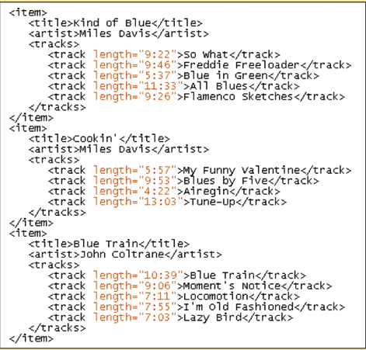
Attribute Example
{
Elements with attributes

Slide 30
JavaScript and XML
Traverse the document by getting the nodes you want into an array
Use getElementsByTagName and specify the highest level element that contains the elements you want.
Loop through the elements returned
For each child element you want to manipulate, use getElementsByTagName again to get that element
This returns an array with (hopefully) one member so access that member as the first array element (element[0])
Each element has a number of child nodes in an array
The first child node is the value of the node and is accessed using childNodes[0].nodeValue
To get an attribute use element.getAttribute(‘attributeName’)
Notes:
Show example11

Slide 31
XML DOM Nodes
Everything in an XML document is a node
The entire document is a document node
Every XML element is an element node
The text in the XML elements are text nodes
Every attribute is an attribute node
Comments are comment nodes

Slide 32
DOM Methods and Properties
Typical DOM properties:
x.nodeName - the name of x
x.nodeValue - the value of x
x.parentNode - the parent node of x
x.childNodes - the child nodes of x
x.attributes - the attributes nodes of x
Typical DOM methods
x.getElementsByTagName(name) - get all elements with a specified tag name
x.appendChild(node) - insert a child node to x
x.removeChild(node) - remove a child node from x

Slide 33
getElementsByTagName()
Returns array (node list) of all elements with Tag Name
node.getElementsByTagName("tagname");
If responseXML has been assigned to variable xmlDoc
xmlDoc.getElementsByTagName("title");
creates an array of all the elements in file from the document (root) node

Slide 34
XML DOM Simple Example
Once you isolate the element using getElementsByTagName
Get the attributes using the attributes property
Get the value or name by using the appropriate property
x=doc.getElementsByTagName("book")[0].attributes;
x.getNamedItem("category").nodeValue

